Slide 1

Enron Global Products
Project Thunderball
June 1, 2000

Slide 2
Project Thunderball
Table of Contents
Thunderball Overview
Changes to Scope
Update on Project Moneypenny
Update on Project Q
Update on Esprit
SAP
Key Items
Timeline

Slide 3
Project Thunderball
Project Thunderball describes a series of incremental projects that will, over time, replace the existing disparate systems within Global Products, with a fully integrated suite of systems, which provide:
Electronic deal capture. (Project Moneypenny)
Intra-day position reporting. (Project Moneypenny)
Logistics. (Project Q)
Valuation. (Project Esprit)
End-of-day position and P&L reporting. (Project Golden Eye)
Invoicing & Settlements. (Project Gold Finger)
Documentation (Project Odd Job)
Global deployment

Slide 4
Project Thunderball
Scope Changes & Re-definition
Pulp & Paper
  Required two technical developers and one BA that were intended to work on Thunderball.
Elimination of Pub Codes
  ERMS pub code options
    Eliminate pub codes
    Streamline and automate creation of pub codes.
  Current thinking is the elimination of pub codes may have adverse effects to downstream processes unknown today. Additional research needs to be done to select the best solution.
Q
  Phases changed from types of movements to additional functionality

Slide 5
Project Thunderball
Project Moneypenny
Accomplishments
Q and Moneypenny teams agreed to a common schema for physical trades.
Agreement on methodology for handling non-working days in event driven pricing.
Technical resource hired - Tim Leggett. An additional technical resource is in process of hire - Dow Ripley (contractor from SourceBank).
Have met with OSI and SourceBank on additional resources. OSI is keen to assist, but currently do not have any resources in Houston.
Reviewed Security Model with IT Compliance. No changes expected.
Met with TDS team to discuss using components to link to TAGG/ERMS. Karema Husain to document technology and process.
Purchased development and test server.
Functional specifications document for deal capture started.

Slide 6
Project Thunderball
Completion of Functional document by mid June.
Completion of Technical document by end of June.
Proto typing of user interface to begin.
Addition of three technical resources by end of June.
Finalize Database schema for Trade capture by June 5.
Finalize Security model.
Research and document technical requirements to interface to TAGG/ERMS. These interfaces exist in the current applications that Enron uses today, namely EOL and TDS.
Project Moneypenny - KEY Upcoming Milestones

Slide 7
Project Thunderball
Project Moneypenny Resource Requirements
Business Manager: Kevin Sweeney
Project IT Manager: Iain Greig
Business Analyst: Karema Husain/Dan Cole
Business Resources: Richard Cross
Data Architect: Alexandra Burnett
Database Administrator: Mable Tang
Developers: Tim Leggett
        Andy Mayo
        Dow Presley
        TBD
        TBD
        TBD

Slide 8
Project Thunderball
Project Q - Accomplishments
Tactical Milestones
  All tactical milestones are complete as of May 1, 2000. London and Helsinki are using these current solutions.
    Access database to capture key contract and shipping details.
    Logistics planning tool MS Excel.
    Storage spreadsheet MS Excel.
    Vessel spreadsheet MS Excel.
Strategic Milestones
  Functional document complete and signed off by project sponsors.
  Technical document in process of completion.
  Proto typing of user interfaces have started.
  Data Model in finalization.
  Q and Moneypenny sync on data model.
  Enron technical lead, Scott Lytle, in place as of 5-30-2000.

Slide 9
Project Thunderball
Completion of Technical document.
Addition of one technical resource.
From mid to end of June unit testing.
July 3 starts user acceptance testing for Phase I.
  All functionality for Helsinki and London.
    Tactical deal capture (replaced by Moneypenny)
    Logistics Planning/Scheduling
    Storage
    Vessels,rail, truck
    Controls/Auditability
August 1 production implementation of Phase I for London and Helsinki.
Phase II functionality includes:
    Formula Price Calculator
    Integrate with CAS, Global Data, and Liquids Accounting
Phase III additional functionality related to Pulp & Paper and Methanol Distribution
Project Q - KEY Upcoming Milestones

Slide 10
Project Thunderball
Project Q Resource Requirements
Business Manager: Cindy Horn
Enron Technical Lead: Scott Lytle
OSI Technical Lead: Tim Dutton
Business Analyst: David Rae
Business Resources: Graham Cane (consulting)
Sylvie Mostura (consulting)
Claire Plews (100%)
Data Architect: Cindy Wisemiller
IT Developers:
  Phil Meads
  TBD
  2 OSI (100% dedicated)

Slide 11
Project Thunderball
Project Esprit
Phase I
Speed up PortCalcs.
  PortCalc has been moved from SunOS to Solaris.
    Business has seen a 50% increase in performance.
  MetaCalc has generated some issues which have been estimated to be resolved by end-of -week 6-2-2000.
Eliminate Pub posting process
  Timeline will need to sync with Trade capture (Moneypenny) implementation.
  Scope of deliverable is in research to change from eliminating the Pub Code to Automatically creating the Pub Code from Moneypenny.
Price Formula Calculator
  This module will help replace the Solarc/RightAngle software.
    Functional document created.
    Additional IT Resources required.
Define strategic direction
  Build in house
  Buy package
  Leverage internal systems

Slide 12
Project Thunderball
Project Esprit Phase I Resource Requirements
Business Managers: Kevin Sweeney/Cindy Horn
Project IT Manager: Tom Moore
Business Analyst: Karema Husain
Business Resources: Richard Cross
Mark Fondren (25%)
Data Architect: Cindy Wisemiller
Database Administrator: Toby
Developers: 3 (TBD)

Slide 13
Project Thunderball
IT Resources
  Moved Phil Glass to technical team to help manage the SAP implementation through June - August.
  Gloria Gou has stepped up to take the technical leadership role.
  Additional developer, Monica Jones, starting 6-5-2000.
Business Resources
  Business resources for Project Goldfinger and Project Golden Eye currently engaged in the SAP project until mid August.
Testing
  Testing of FIT 3 in progress.
  Initial results look favorable.
Transition Plan
  Shelly Stubbs and Phil Glass will develop a transition plan for Enron Global Products move from MSA and Sun to SAP. Plan is expected to be complete by mid June.
SAP

Slide 14
Project Thunderball
Moneypenny
  Additional IT resources.
  Implementation at a desk by desk basis.
  Disable the Q deal capture as Moneypenny becomes active.
  Disable TAGG deal capture when Moneypenny becomes active.
  Retro fit active physical deals into Moneypenny.
  Automate current pub posting process instead of eliminate pub code, within the TAGG/ERMS environment.
  Dedicated TAGG/ERMS resource.
  Integration Global Data, TAGG/ERMS, Q, and Dcaf.
Q
  Additional IT resources.
  Integration of CAS, Global Data, and Liquids Accounting.
  Price Formula Calculator
Esprit - Price Formula Calculator
  Additional IT resources.
  Leverage in automation of pub code creation & pub code posting.
Project Thunderball - Key Items

Slide 15
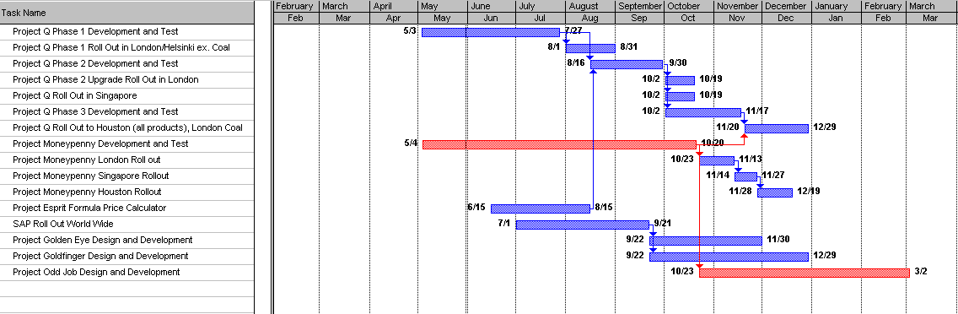
Project Thunderball Timeline

